Slide 1



littleBeasts
the falllen star of arkham

Slide 2
Agenda
Our Vision
The World
The Scope
Demo
Technologies
High-Level Architecture
Live Test Session
Project Management
Workflow

Slide 3

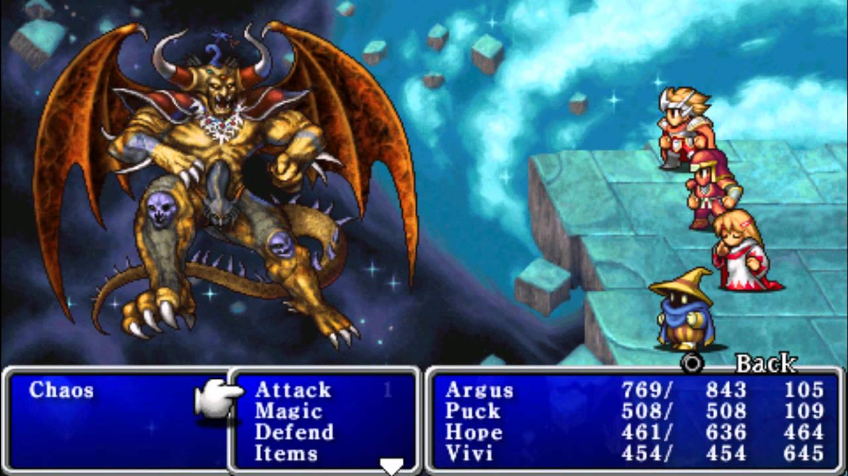


Our Vision

Slide 4

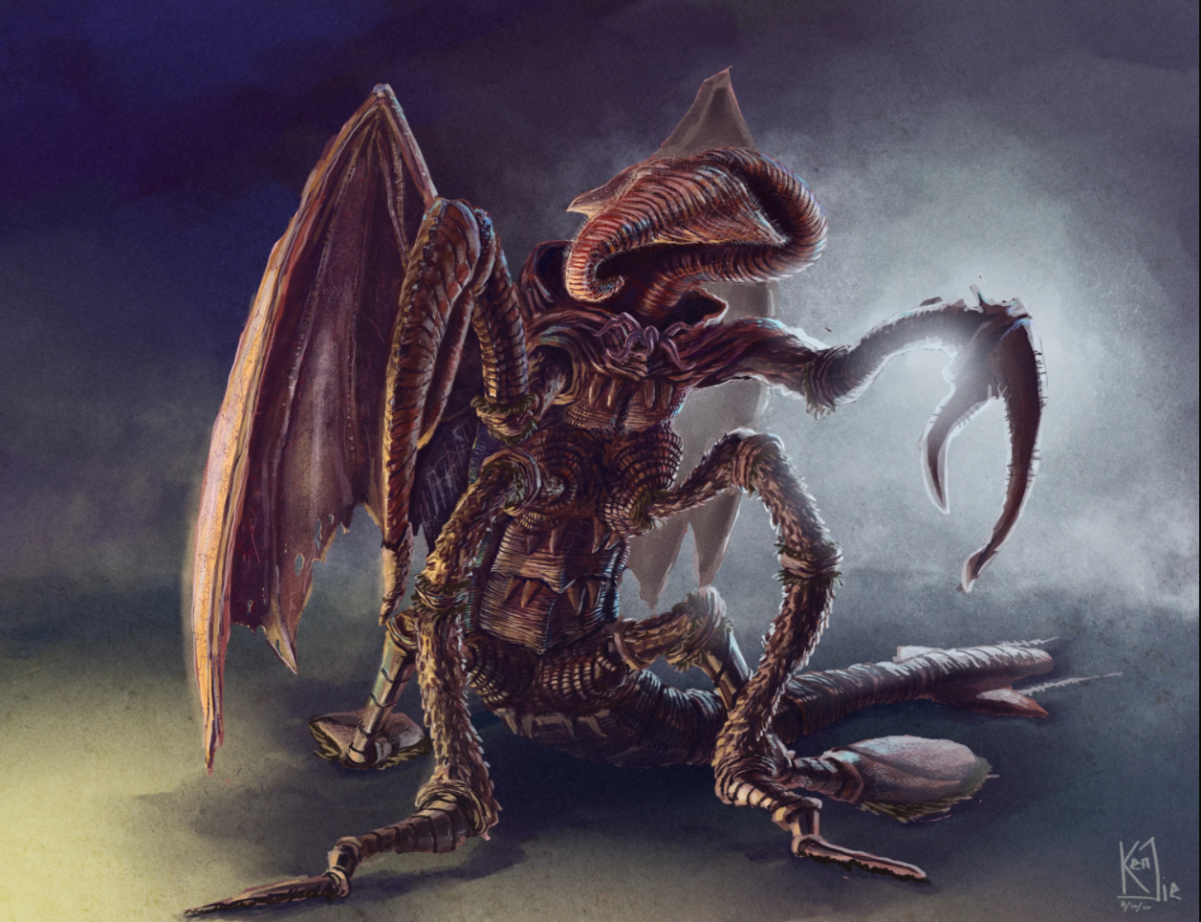
The World

Slide 5
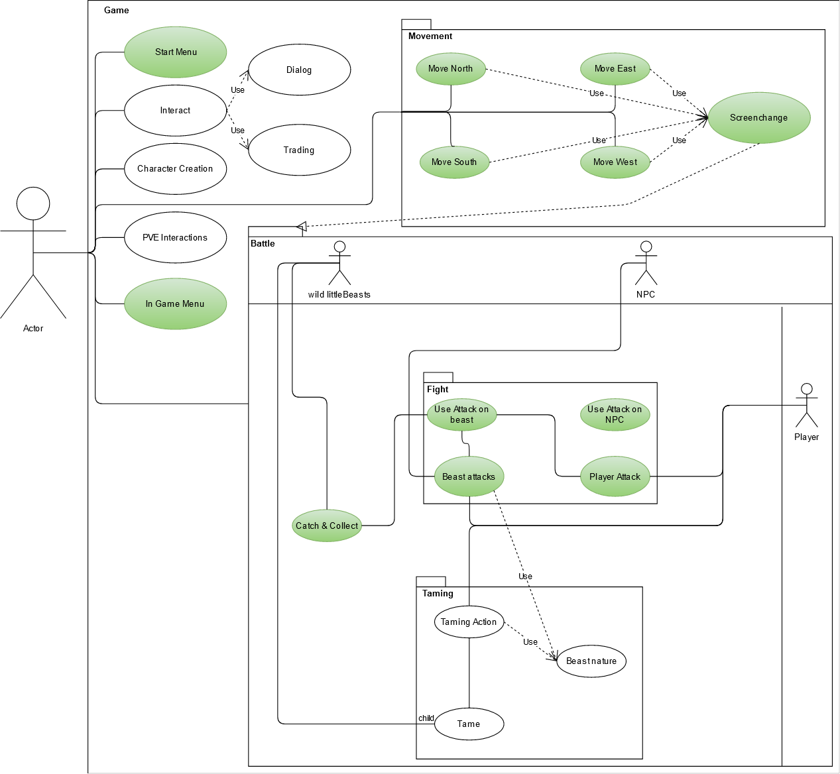
The Scope
Legend:
Green: Current Scope, already implemented
White: tbd.

Slide 6
LIVE DEMO

Slide 7
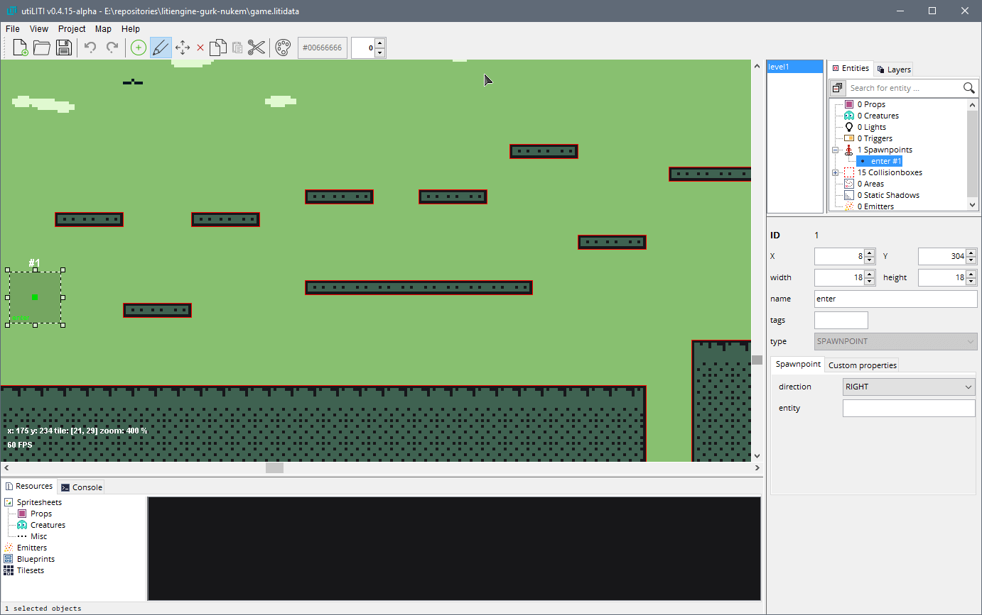



Technologies - LitiEngine

Slide 8
High-Level Architecture
Com.littleBeasts
Config
CalculationEngine
Screens
Gamelogic
Player Input
Animations
Enum for easy configuration and balancing
Includes data models
Generates entities
Handles Battle
AI for PVE
Future proof -> Multiplayer

Slide 9
Live Test Session

Slide 10
Project management

Slide 11
Roles
Lawand: Implementer, Integrator, Test Manager, Test Designer, Designer
Andreas: Implementer, Integrator, Test Analyst, Designer, Deployment Manager
Daniel: Business Process Analyst, Lead Story Architect, Change Control Manager, Process Engineer
Leon: Project Manager, Change Control Manager, Software Architect

Slide 12



Youtrack / Scrum

Slide 13
Workflow
YouTrack
Research phases
Refactoring
IntelliJ
Code Review
Refactoring
Github
Tests

